Slide 1
Product Recommendation System
Rotem Bar
08/02/2022

Slide 2
Table of Contents
Introduction - Recommendation Systems
Methodology
Related Work
Background- word2vec Embedding
A Code - Walkthrough
Discussion and Conclusions

Slide 3
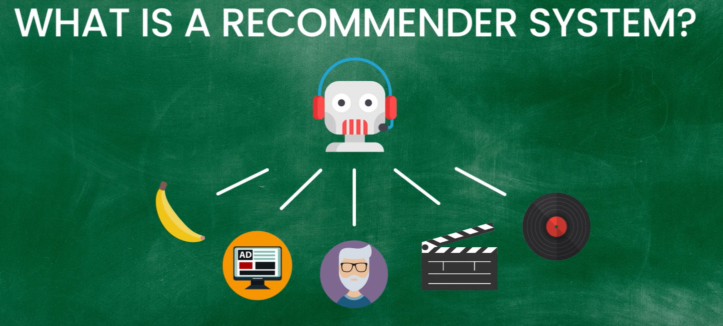
Introduction - Recommendation Systems

Slide 4
Introduction - Recommendation Systems
Input:
Item_x (1+)
Recommendation System
Item_1
Item_2
Item_3
Item_4 ?
Item_5 ?

Slide 5
Methodology
Input
Encoders
Classifier
Item
Date
Channel
Daypart
word2vec (avg)
Logistic Regression
P
OneHotEncoding
Item_1, Item_2, Item_3

Slide 6
Literature Overview
Author | Year | Paper name
Caselles-Dupré et al. | 2018 | Word2vec applied to recommendation: Hyperparameters matter
R Esmeli et al. | 2020 | Using Word2Vec recommendation for improved purchase prediction
JW Baek and KY Chung | 2021 | Multimedia recommendation using Word2Vec-based social relationship mining
BP Chamberlain et al. | 2020 | Tuning word2vec for large scale recommendation systems
JT Oh and SY Lee | 2020 | A Movie Recommendation System based on Fuzzy-AHP and Word2Vec
S Gu et al. | 2021 | Research on application of article recommendation algorithm based on Word2Vec and Tfidf
J Pan et al. | 2019 | Order matters at fanatics recommending sequentially ordered products by LSTM embedded with Word2Vec

Slide 7
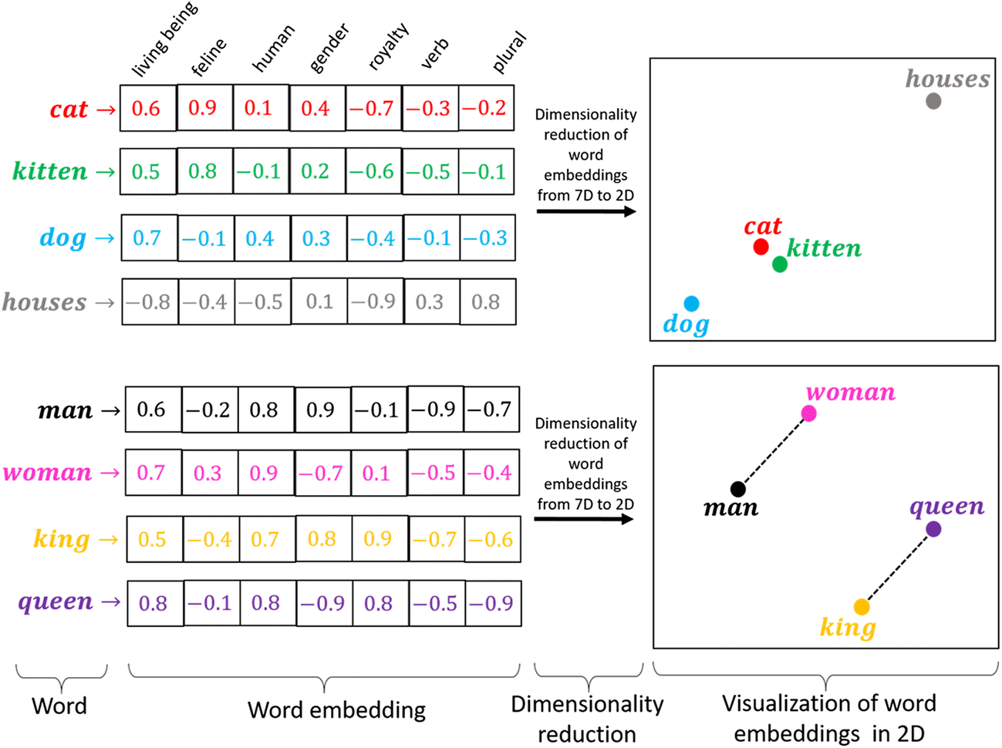
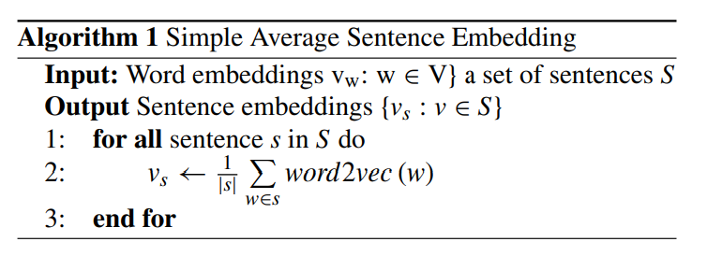
Word Embedding

Slide 8
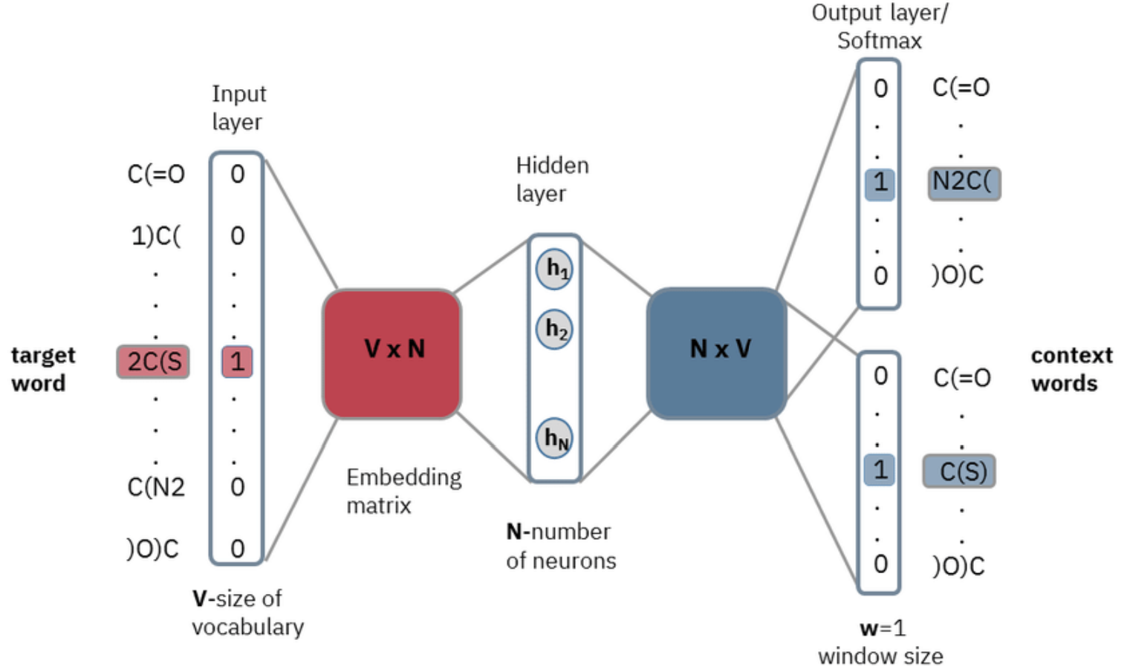
word2vec
Item_1 Item_2 Item_3 Item_4 Item_5

Slide 9
Discussion and Conclusions
Hit-rate results: 66.3%
Hit-rate per item: 49.1%
Word2vec learns the semantic relationship between the items.
Future work:
Testing different methodologies, for example, reinforcement learning, unsupervised(Matrix Factorization), and Cosine similarity.
Model optimization: embedding vector size, regularization (L1/L2), classifier (SVM).
Top 4&5 threshold tuning with a validation set.

Slide 10
THANKS!
ANY QUESTIONS?

